Slide 1
Thermal control / Protection Algorithm
Tulasi, NOV 20, 2011

Slide 2
Concepts
Maintain required temperature levels during sample preparation and amplification process
Three state control algorithm
    Sample preparation state
    Amplification state
    Emergency and shutdown
  Each state will have mitigation strategy
Configurable set values for experimentation

Slide 3
Requirements
Mitigation temp threshold for sample preparation : > 15 deg C
Mitigation temp threshold for amplification process: @ 65 deg C
Temp threshold emergency mitigation: > 65 deg C

Slide 4
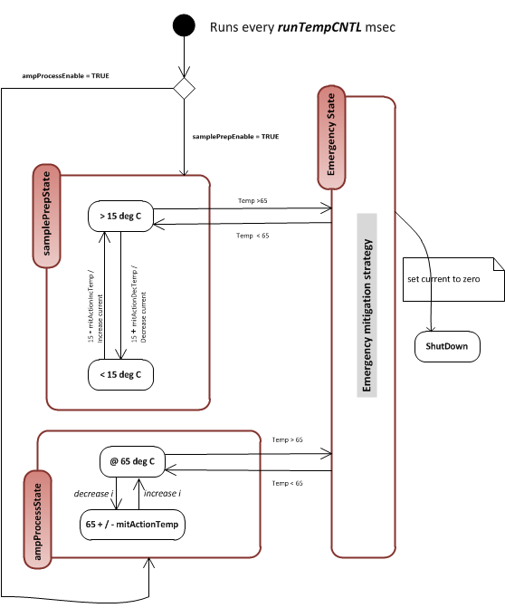
Algorithm run frequency
  runTempCNTL
Enabling amplification process
  ampProcessEnable
Enabling Sampling preparation
  samplePreEnable
15 + mitActionDecTemp / Decrease current :
  If the temp is (15+mitActionDecTemp ) then decrease current
15 - mitActionIncTemp / Increase current
  If the temp is (15 – mitActionIncTemp) then increase current
  E.g.
    If temp is 20 deg C then decrease current
    If temp is 14 deg c then increase current
Target current values:
  configurable
  Start with 5 defaults
  Total 10 values
  The algorithm will follow this values during increasing / reducing current
65 + / - mitActionTemp:
  This will decide when we need to increase or decrease the current
Emergency shutdown
Handling temperature sensor failures

